Slide 1
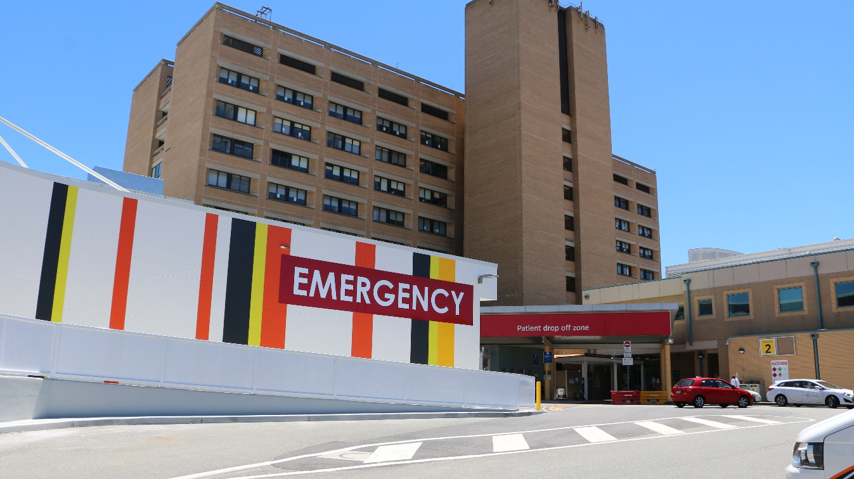
Intern Recruitment 2024
Janelle Corey
Senior Director
MOSCETU

Slide 2
MOSCETU/JMO Education Program
The Medical Officer Support, Credentialing, Employment and Training Unit (MOSCETU) and the Director of Prevocational Education & Training (DPET) support post graduate medical education and training through development of contemporary orientation programs, ongoing training programs for interns and RMOs and providing a professional development program for registrars. We also provide organisational management of the junior medical workforce including administrative support for rostering, recruitment and JMO welfare.
The hospital has well-developed postgraduate teaching programs. Compulsory intern teaching sessions are conducted every week for all interns based in the ACT. We conduct weekly voluntary RMO teaching sessions across a variety of topics. All units also conduct regular teaching sessions for junior medical staff and there are dedicated weekly education sessions.

Slide 3
ACT Network
JMO Rotations (PGY1-2) are available at Canberra Hospital, Calvary Hospital, Goulburn, Moruya (PGY2 only), Cooma (PGY2 only) and Bega Hospitals.
These rotations are very diverse from the Emergency Department through Surgical and Medicine rotations (in both ACT and rural locations) to Justice Health at the Alexander Maconachie Centre and Public Heath rotations.
A planned, co-ordinated and flexible approach is taken in the preparation of the junior medical officer (JMO) rotations. Each major discipline has a senior staff member appointed as a mentor to advise Interns/RMOs on career options and choices (PMEO).
John Flynn Prevocational Doctors Program – Bega

Slide 4
Intern Rotations - 2024
Rotations are pre-allocated – you will be notified by end of October 2023.
Four term year – each term 12-13 weeks
Some relief positions in Medicine/Surgery (Pod positions)
47 week total for General registration.
Emergency Medicine (8 weeks) – CHS/Calvary/Bega
Medicine (10 weeks) – Cardiology, Endocrinology, Gastroenterology, Infectious Disease, Renal, General Medicine, Neurology, Respiratory, Geriatrics, Haematology, Medical Oncology, Bega/Goulburn/Calvary
Surgery (10 weeks) – ASU, ENT/Max Fac, General Surgery, Neurosurgery, Plastics, Vascular, Urology, Orthopaedics, Bega/Goulburn/Calvary
Other – O&G, Drug & Alcohol, Psychiatry, HITH

Slide 5
Application Process
Complete online profile through the Canberra Health Services system – www.canberrahealthservices.act.gov.au
There is a question about what qualifications you hold – Australian trainee
Which Network – TCH/Bega or Calvary/Goulburn?
Attach pitch response to the selection criteria – Mandatory
International students – Meet AHPRA study requirements or IELTS (dated no earlier than July 2022)
Provide referees with template and advise them to submit directly to Canberra Health Services (instructions on form)
Applications close on 8 June 2023
1st round offers on 19 July 2023– in form of contract via email
AUDIT Process – refer to flyer

Slide 6
Priority List - 2024
Priority List
Category 1a | Guaranteed First Round Offer * CSP Graduates of the Australian National University Medical School
Category 1b | Guaranteed First Round Offer (capped at SIX) * Domestic CSP Graduates of NSW Universities.
Category 1c | Guaranteed First Round Offer * Aboriginal and Torres Strait Islander Graduates of other Australian universities (who provide a statutory declaration regarding aboriginality)
Category 2 | First Round Offer Not Guaranteed Graduates of other Australian Universities who completed Year 12 studies in the ACT.
Category 3 | First Round Offer Not Guaranteed IFF Graduates of the Australian National University Medical School.
Category 4 | First Round Offer Not Guaranteed Graduates of other Australian Universities.
Category 5 | First Round Offer Not Guaranteed Graduates of Australian University campuses outside of Australia accredited by the Australian Medical Council.

Slide 7
General Information
2024 new starter/orientation information will be sent out in approx. Oct 2023
Visa process for international students – 485 Visa (not employer sponsored)
Rotations meeting AHPRA requirements will be allocated - no preferences
Part time may be available – must identify this at time of application
Orientation – Commencement Date 8 January 2024 – clinical year commences 5 Feb 2024.
Change to intern requirements for 2024 (you will be the first year!).

Slide 8
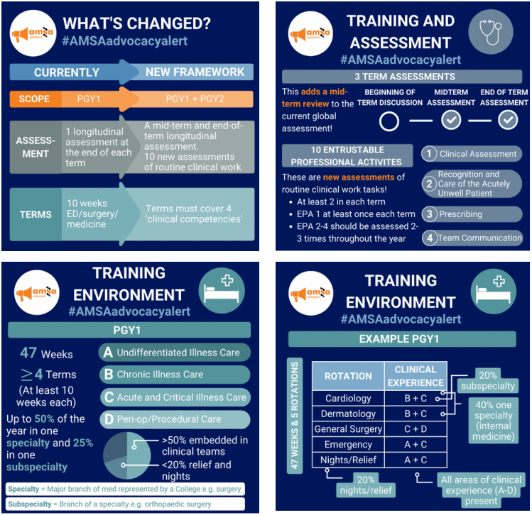
Changes to Internship – 2024 (Thanks to AMSA for graphics)

Slide 9
Why Canberra Health Services?
Up to $4000 in relocation subsidy
Full two week orientation program with three days of supernumerary
No after hours shifts for first 4-6 weeks, aim to have most interns complete a MET simulation before starting after hours shifts
~$1100 pa in education allowance + ~$900 in mobile phone allowance (depending on rotations)
Rural rotations (Bega, Goulburn) available if you apply for them
Fully integrated digital health record (DHR) across the territory
New Critical Services Building opening in 2024
Can undertake most training programs here.
Major tertiary trauma hospital that is easier to get into than VIC/QLD/NSW
Very easy to get involved with ANUMS teaching and can apply for clinical skills tutor title as an intern

Slide 10
Thank you

